Slide 1
Understanding the barriers and the possibilities
A study of people with disabilities and their lived experience of the labour market
Dr Josefine Nyby
Dr Jane Lewis
Dr Sandra Fernando

Slide 2
Overview of the presentation
Background: UK context
Aim of the project
Methodology (comments particularly welcome here)
Findings (quant and qual)
Discussion (comments particularly welcome here)

Slide 3
Background: UK context
To decrease the disability employment gap has been on the UK political agenda since 2017
Equality Act 2010
Physical or mental impairment that has a ‘substantial’ and ‘long-term’ negative effect on the ability to do normal daily activities
Public sector equality duty
Employer: Reasonable adjustments
Yet, people with disabilities are disproportionately affected by poverty, combined lower employment rates, higher under-employment and out-of-employment rates and lower educational attainment
Notes:
For working-age population the poverty rate is at 18% compared to 35% for people with disabilities
A person who is employed is someone who works at least one hour per week;
a person who is unemployed is a person who is not employed but wishes to start employment;
a person who is under-employed is an employed person who wishes to and can work more hours or/and is working with tasks where their abilities and qualifications are above what the task requires;
a person who is out-of-employment is a person who is aged 16-64, but for some reason is outside the labour market through e.g., studies of early retirement.

Slide 4
Aim of the project
Collaboration between researchers at LMU and a Borough in London (Borough X or Council X)
As in line with EA (2010) councils can set up employment support services and various schemes, and Council X was interested in knowing what works and what does no
To get a better understanding of people with disabilities and their lived experience of the labour market
To present policy suggestions for improving labour market participation and services based on the evidence collected

Slide 5
Methodology
Go beyond the homogenous ‘disabled’ category
Quantitative data (localised service data provided by Council X, official local and national statistics)
Qualitative data: focus group interviews with five ‘sub-groups’ of PwD
Residents with learning disabilities (2 women, 4 men)
Residents with mental health problems (6 women)
Deaf residents (8 women, 4 men)
Residents with visual impairments (1 woman, 3 men)
Residents with physical disabilities (4 women, 2 men)
Comments particularly welcome:
Theoretical framework: still a work in progress, but SIP a possibility
Analysis: thematic analysis

Slide 6
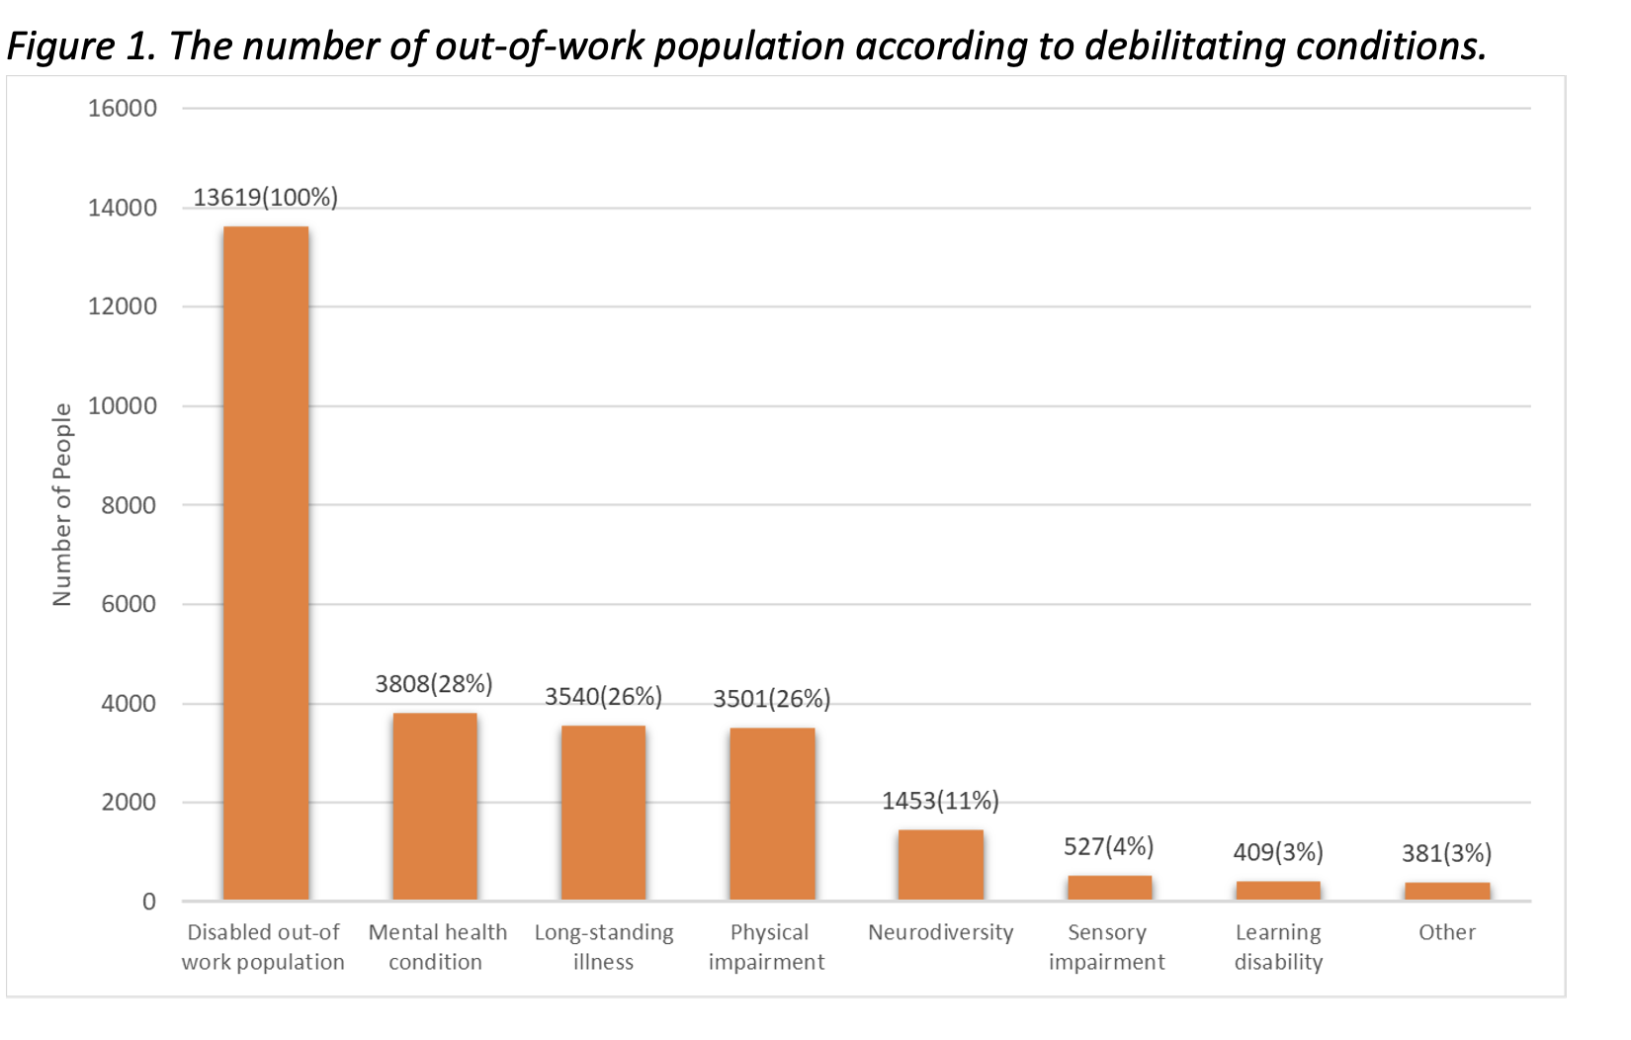
Findings: quantitative

Slide 7
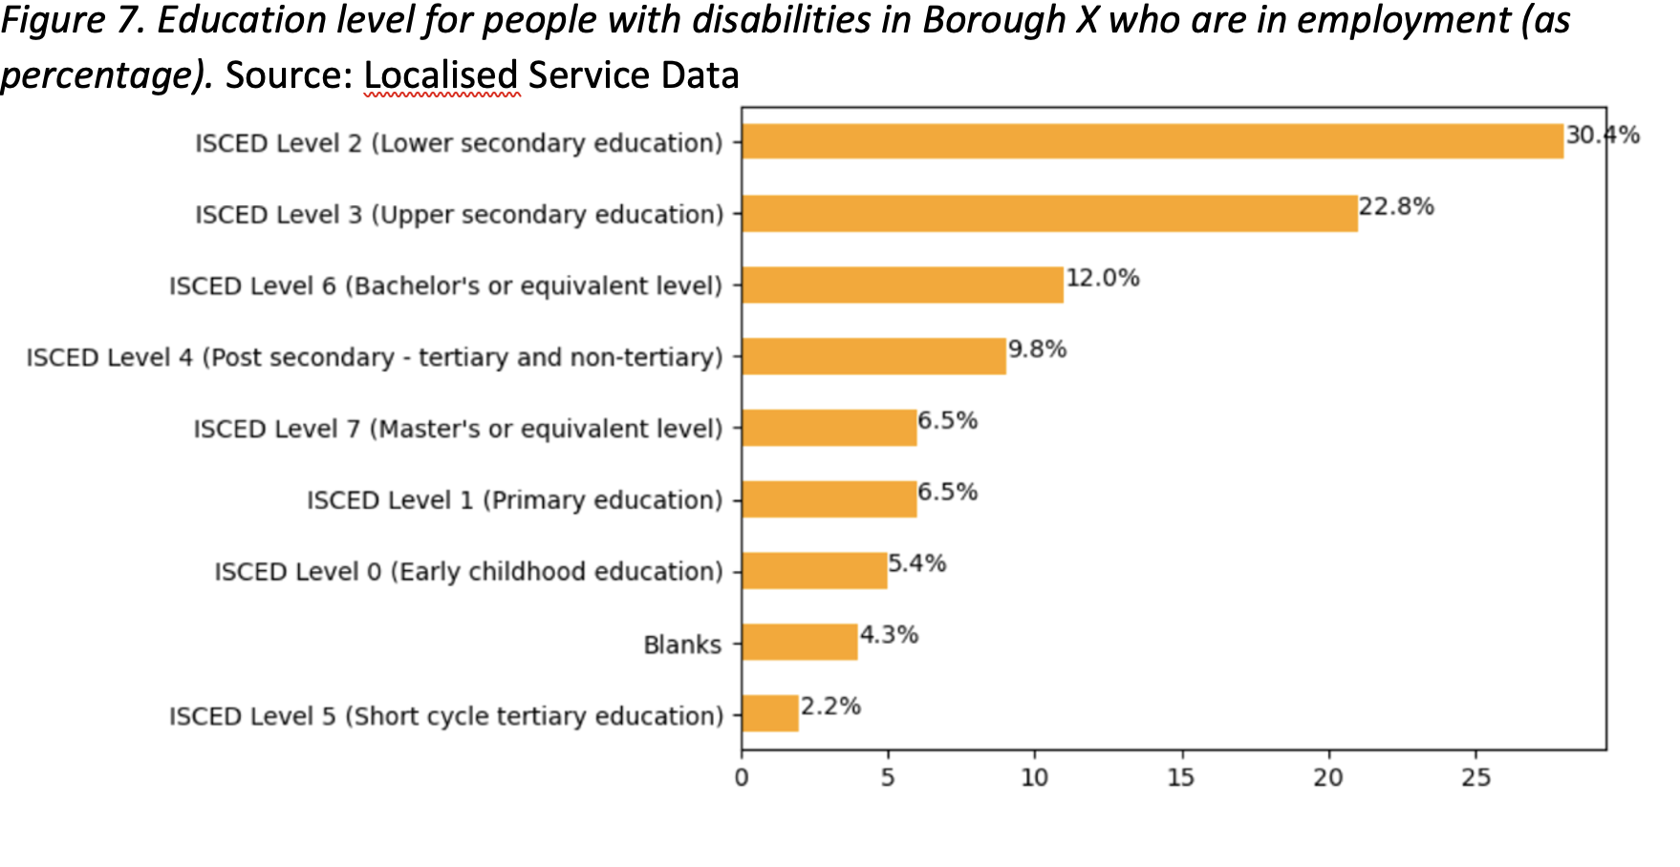
Cont.

Slide 8
Findings: qualitative
Common for all focus groups:
Overwhelming majority were unemployed or under-employed, but incredible willing to work
Discrimination and prejudice (already in the recruitment process)
Complex and multiple health conditions (particularly mental health)
Intersectionality (age, gender, ethnicity) key part in the experiences
Particular findings (selection)
Learning disabilities: phone interviews a barrier
Blind/partially sighted: online application
Deafness: misunderstanding of their cognitive abilities and fire alarms
Mental health: misunderstanding of mental health

Slide 9
Discussion
London context – relevance for national or international policy-making?
Small sample (qualitative) – reliability?
Advice on turning policy research into research papers?
Methodological paper?
Two papers instead of one?

Slide 10
Thank you for your attention! Comments are most welcome.
Dr Josefine Nyby (j.nyby@londonmet.ac.uk)
Dr Jane Lewis
Dr Sandra Fernando

