Slide 1

On the Need for an International Biosecurity Education Network
Maeva Khachfe
Lijun Shang
Biological Security Research Center
London Metropolitan University

Slide 2

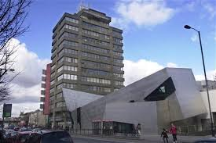
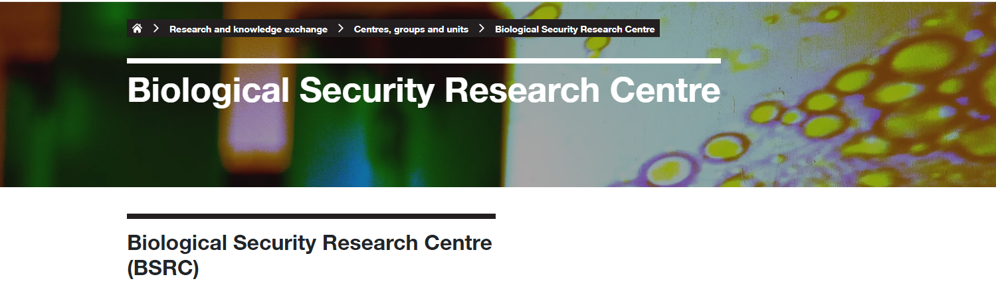
https://www.londonmet.ac.uk/
https://www.londonmet.ac.uk/research/centres-groups-and-units/biological-security-research-centre/

Slide 3
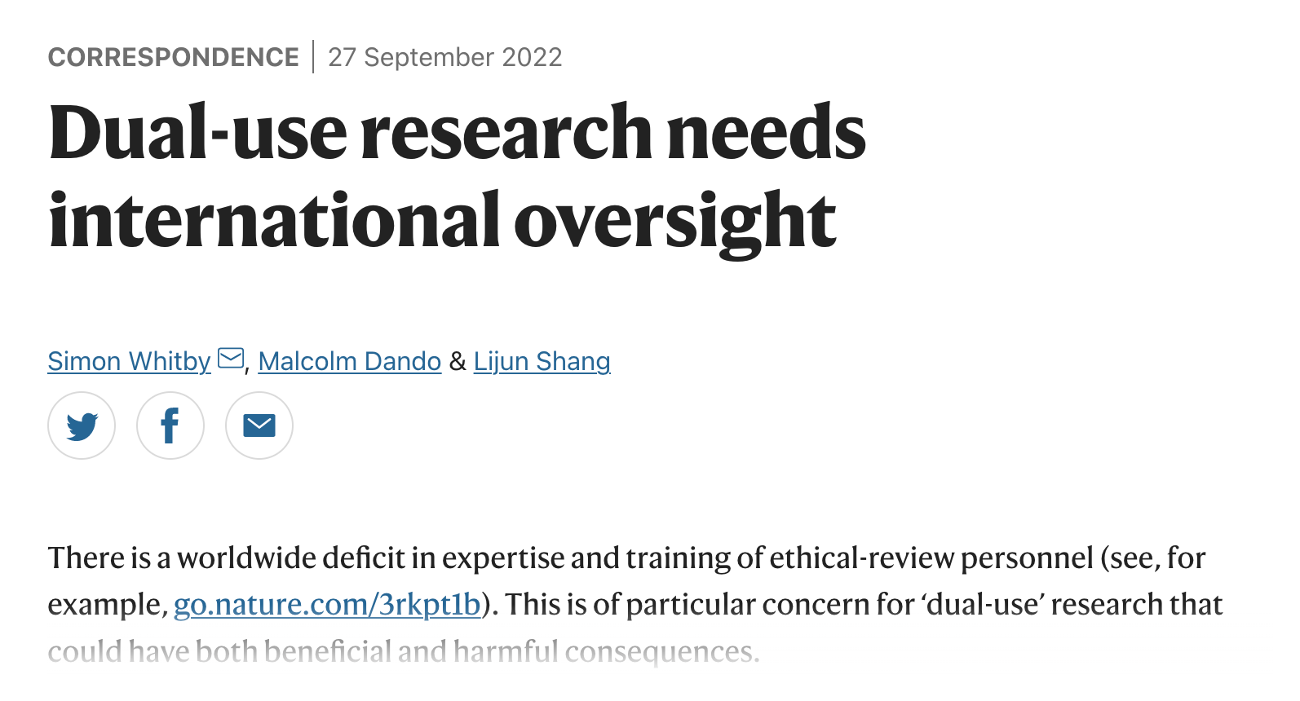
Recent relevate publications
Nature

Slide 4
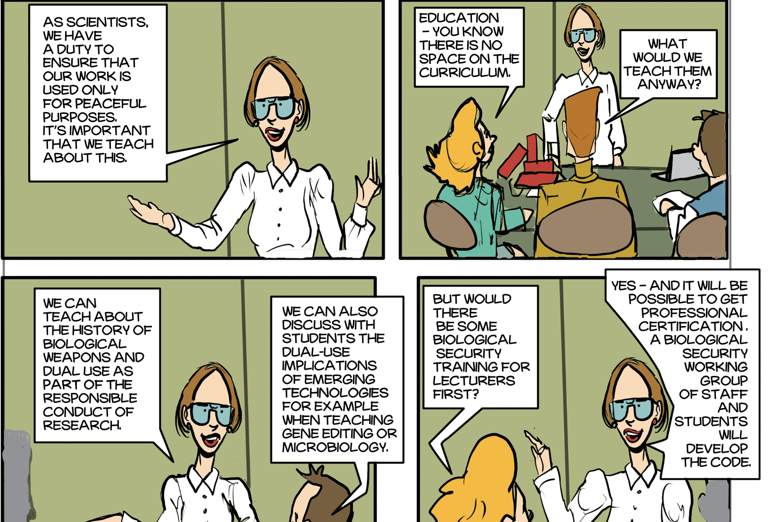
Codes of Conduct

Slide 5
to be published
June 2024

Slide 6
Recent relevant Publications
Dual-use oversight: Is the scientific community fit for Purpose? What should be done if it is not? Journal of Biosafety and Biosecurity, 2023, https://doi.org/10.1016/j.jobb.2023.11.001
A key role for scientists in strengthening the Biological Weapons Convention. Front. Polit. Sci. 5:1265008. 2023, doi: 10.3389/fpos.2023.1265008
Rethinking biosecurity in the 21st century: An enhanced role for civil society. Journal of Biosafety and Biosecurity, 2023, https://doi.org/10.1016/j.jobb.2023.07.004
Meeting the Challenges of Chemical and Biological Weapons: Strengthening the Chemical and Biological Disarmament and Non-proliferation Regimes. Front. Polit. Sci. 4:805 426. 2022, doi: 10.3389/ fpos .2022.805426
Strengthening the Biological and Toxin Weapons Convention after COVID-19. Translational Toxicology and Therapeutics, 2022, https://pubs.rsc.org/en/content/ebook/978-1-83916-306-7
Key issues in the implementation of the Tianjin Biosecurity Guidelines for codes of conduct for scientists: A survey of biosecurity education projects, Biosafety and Health (2022), doi: https://doi.org/10.1016/j.bsheal.2022.08.003
Dual-use research needs international oversight. Nature. 2022, doi: 10.1038/d41586-022-03011-0. PMID: 36167995.

Slide 7
Recent relevant grants

Slide 8
Planned events in 2024
Book Launching (June)
IBSEN workshop (July/August)
We welcome everyone who would like to collaborate with LMU BSRC in this task and the general BWC issues.

Slide 9
Acknowledgements - thanks to various grants from the Joseph Rowntree Charitable Trust
London Metropolitan University & collaborators around the world

