Slide 1
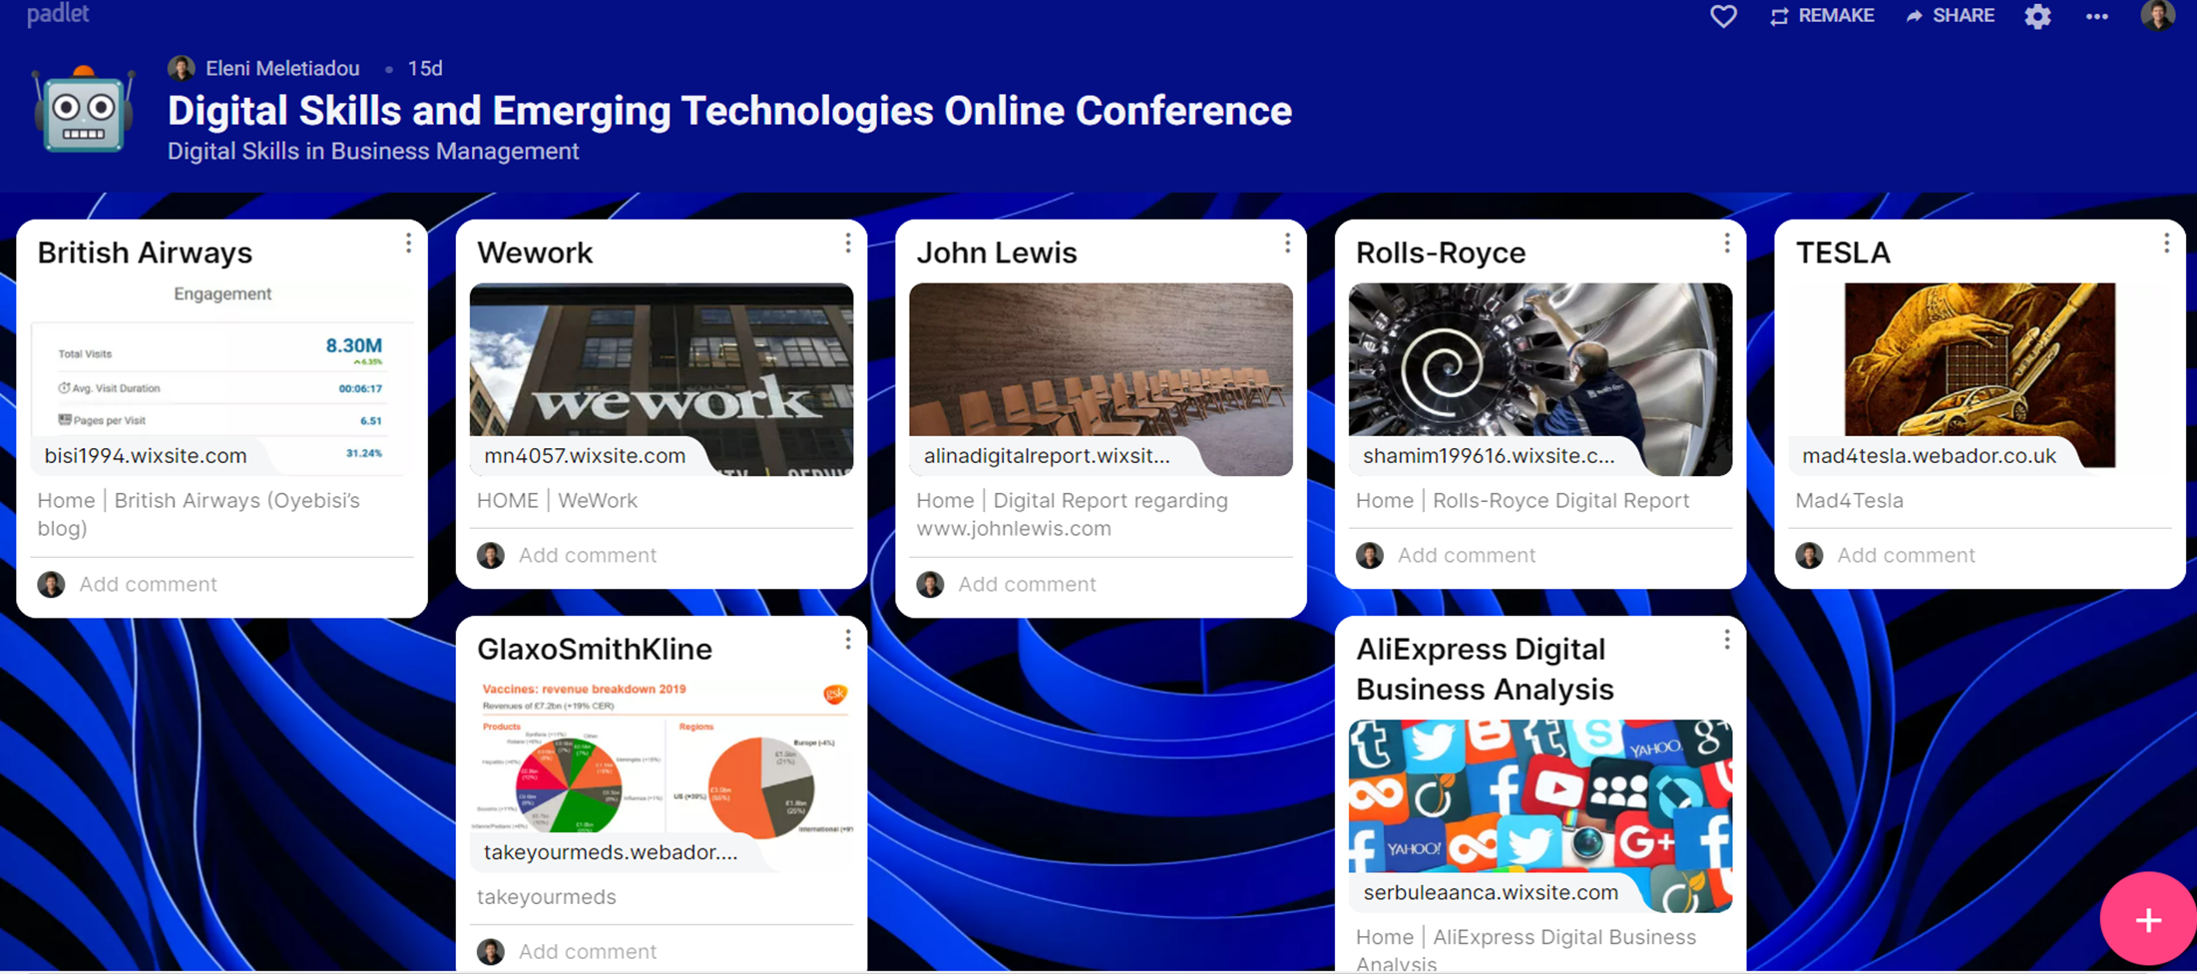
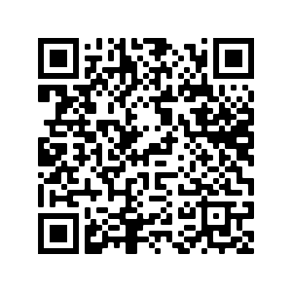
Exploring the Use of Educational Digital Storytelling with Multilingual and Multicultural Business Students: Implications for Enhancing Learners’ Academic Writing Skills
Introduction
Methods
Implications/Recommendations
Although various studies have explored EDS in primary (Liu et al., 2018) and secondary education (Anderson et al. 2018), few studies have explored the impact of EDS on Ss’ writing skills (Balaman, 2018) and motivation (Hava, 2019) in HE.
Educators need to:
be cautious when using this new technique - i.e., Ss may not have access to the internet.
support mature Ss who might have limited experience in using digital skills.
provide necessary training and continuous support to avoid any kind of discrimination.
emphasize the product as well as the process as Ss develop their academic skills while preparing their digital stories.
focus on assessing Ss’ writing skills rather than the elements that Ss use to make their stories more attractive.
have a detailed plan which can guide the Ss.
have clear assessment criteria and ensure they match with the curricular goals.
ensure all students have access to the necessary equipment, i.e., laptop.
The aim
The current study explored the use of EDS with undergraduate Business School students to develop multilingual and multicultural learners’ writing skills and enhance their motivation towards learning in the post-Covid era.
Description of the study
Question 1
What are students’ attitudes towards the use of Educational digital storytelling in Business and Management Studies?
Educational Digital Storytelling (EDS)
Academic Achievement (writing)
High-achieving
students
Average-achieving
students
Low achieving
students
Men vs
Women
Question 2
What is the impact of using this approach on students’ professional skills, i.e., digital literacy, writing, self-regulation, motivation)?
4
10
36
29 vs 21
Sample of Ss’ work
According to research, Educational Digital Storytelling (EDS) is a pioneering learning-oriented technology-enhanced approach which allows students (Ss) to develop a wide range of academic and professional skills (Yildiz Durak, 2018).
Ss were asked to tell their own digital stories using either blogs, websites or video presentations and were engaged in interactive seminars for a whole academic semester.
EDS provides an opportunity for Ss to solve problems and develop their digital skills while becoming more confident with technology through experimentation.
This study intended to investigate how to use EDS activities to facilitate students’ digital literacy in HE.
Conclusion
EDS seems to be a viable tool for HEI lecturers who would like to enrich traditional undergraduate courses and allow Ss to have access to and become proficient in the 21st century multimodal literacies.
50 L4 Ss - volunteers -Digital Business Management and Emerging Technologies Module
Ss conducted research on their websites
Anonymous feedback via Mentimeter
They discussed their digital business strategies
Prepare a digital report to tell a story about a company
Entries in an online journal
Findings
Personal information
EDS is a promising innovative approach for improving writing and professional skills.
Ss can exchange ideas and improve their writing skills using both verbal and non-verbal elements.
Ss feel flattered because they have a real audience.
Ss find the development of academic skills more meaningful and engaging.
Ss spend considerable time studying theories and applying them creating real-life scenarios.
Dr Eleni Meletiadou / Senior Lecturer / Course Director
Guildhall School of Business and Law / London Metropolitan University
London, UK
Email: e.meletiadou@londonmet.ac.uk
Bibliography
EDS Implementation Scheme

