Slide 1
Managing attitudes towards sexual difference in large cohort teaching in higher education.
Graham Whitehead
Nottingham Trent University
15 May 2015

Slide 2
Context
Equality Act 2010
Public Sector Equality Duty (part 11, s149)
Managing the interface: sexual orientation and faith - guide for further education and higher education (Lifelong Learning UK 2010)
Higher student recruitment figures across FE/HE

Slide 3
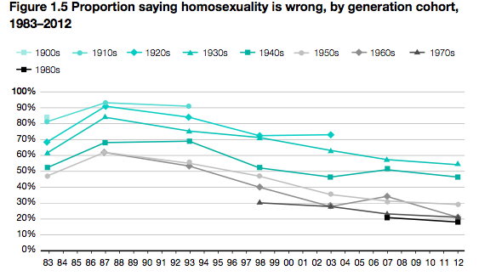
British Social Attitudes Survey

Slide 4
When cultural or discriminatory positions undermine the statutory position: incitement to hatred (DERBY CASE 2012)
Leaflets entitled ‘Death Penalty?’ showed an image of a wooden mannequin hanging from a noose, quoted Islamic texts and said capital punishment was the only way to rid society of homosexuality.

Slide 5
Attitudinal Survey: Whitehead,G. (2015)
Rationale
Target=120 (Actual N=33) Response rate 28%
The sample group of first year students used as a basis to develop recommendations for managing attitudes towards sexual difference in large cohort teaching in higher education.
Method: mixed methods using questionnaire and focus groups
Design: based on Riddle (1994) scale to evaluate levels of response by the cohort. 5 point Likert scale used.

Slide 6
Levels of homophobia: Riddle Scale (1994)
Attitudinal level | Questionnaire Value
Repulsion | 5 Disagree
Pity | 4 Partially disagree
Tolerance | 3 Neutral
Support
Admiration | 2 Partially agree
Appreciation
Nurturance | 1 Agree

Slide 11
Results
Focus group outcomes
Emergent themes:
Inherited values and attitudes
Cultural and religious beliefs may never have been questioned significantly
Recognising the legal position posed a significant challenge for several participants

Slide 12
Recommendations for managing attitudes towards sexual difference in large cohort teaching in higher education.
Challenging a lack of sensitivity to sexual difference can be problematic in large cohort environments – staff need to be trained specifically to promote engagement
The use of e-resources and discussion forums is an effective way to engage the group
Online polls are a useful starting point to begin the debate especially when exploring the interface between sexual difference and religious or cultural viewpoints
Facilitating the debate is central – ethical and moral considerations need to be addressed carefully and with sensitivity

Slide 13
Useful resources
British Social Attitudes Survey see: http://www.natcen.ac.uk/our-research/research/british-social-attitudes Accessed 5/04/15
Dinkel S. Patzel B.McGuire M. Rolfs E. & Purcell K (2007) Measures of Homophobia among Nursing Students and Faculty: A Midwestern Perspective International Journal of Nursing Education Scholarship. Volume 4, Issue 1, ISSN (Online) 1548-923X, DOI: 10.2202/1548-923X.1491, November 2007
Equality & Human Rights Commission Research Report 34 See:http://www.equalityhumanrights.com/sites/default/files/documents/sexual_orientation_research_review.pdf (Accessed 5/04/15)
Lifelong Learning UK (2010) Managing the interface: sexual orientation and faith. A guide for further education and higher education. Avialable at:
Measures of homophobia http://www.degruyter.com/view/j/ijnes.2007.4.1/ijnes.2007.4.1.1491/ijnes.2007.4.1.1491.xml (Accessed 5/04/15)
Riddle (1993) see: http://www.d.umn.edu/~hrallis/professional/presentations/ally_training/riddle_scale.htm Accessed 5/04/15)
Suggestions for combatting homophobia/heterosexism https://www.gvsu.edu/allies/suggestions-for-combating-heterosexism-and-homophobia-41.htm (Accessed 5/04/15)

Slide 14
Appendix 1 Lifelong Learning UK Guidance July 2010
All staff should receive training in how to implement the provider’s equality and diversity policies and/or schemes.
All staff should be trained to understand the
provider’s disciplinary policy and its application
to breaches of the equality and diversity policies and/or schemes.
Academic staff would benefit specifically from
training designed to enable them to deal
effectively with learners who may refuse to
engage with ideas relating to sexual
orientation and/or religion or belief.

Slide 15
Appendix 2 Public sector equality duty
A key development in the Equality Act 2010 is the
public sector equality duty placed on public
authorities (part 11, s.149). The duty requires
public authorities to take a proactive approach to
equality across all of the protected characteristics.
The duty will require a public authority to:
• eliminate discrimination, harassment
and victimisation
• advance equality of opportunity for all
• foster good relations between those who share
protected characteristics and those who do not.

